Slide 1
Optimizing Business Performance Through Employee Engagement
Data-Driven Insights and Strategic Recommendations in Wellcome
22-7-2025

Slide 2
Key Findings
1st Q29 Technology resources
Baseline: 64
4-7% ↑ productivity
+ 18 scores
2nd Q9 Asked Opinion
Baseline: 67
+ 8 scores
17% ↓ shrinkage
3rd Q24 Given Enough Resources
Baseline: 67
+ 6 scores
Engagement Drivers
4th Q30 Community support initiatives
Baseline: 67
+ 16 scores
5% ↓ turnover
+ 5 scores
5th Q23 Meaningful work alignment
Baseline: 67
5% ↑ customer trust(MSP)
Recommend Action

Slide 3
Unexpected Insight Proof
Manager Impact Gap
Q7 (Recommend Manager) ranked lowest in Glint
Q17(Provide Feedback for Improvement) ranked 2nd lowest in Glint
BUT Gallup links it to important
Business Explanation:
Managers matter, but our data shows tools/resources matter more for outcomes!

Slide 4
Appendix
Top 5 Engagement Drivers
 | Wellcome | Overall Stores | SSC
1 | Q29 Technology resources | Q29 Technology resources | Q21 Consider Customer's Needs
2 | Q9 Asked Opinion | Q23 Meaningful work alignment | Q34 Excited about Company's Future
3 | Q24 Given Enough Resources | Q30 Community support initiatives | Q11 Career Opportunities
4 | Q30 Community support initiatives | Q11 Career opportunities | Q15 Trust each other
5 | Q23 Meaningful work alignment | Q8 Action after feedback | Q24 Given Enough Resources
Appendix
Q8: Our company has acted upon the feedback provided in previous Your Voice Counts surveys.
Q9: I am asked for my opinion on ways we can improve.
Q11: I see opportunities to develop my career at our company.
Q15: Across our company, we all trust each other.
Q21: We consider the needs of our customers (internal and/or external) in everything we do.
Q23: The work that I do at our company is meaningful to me.
Q24: I have the resources I need to do my job well.
Q29: Our company is providing the technology resources I need to be productive.
Q30: Our company does a good job supporting the communities in which it does business.
Q34: I am excited about our company's future

Slide 5
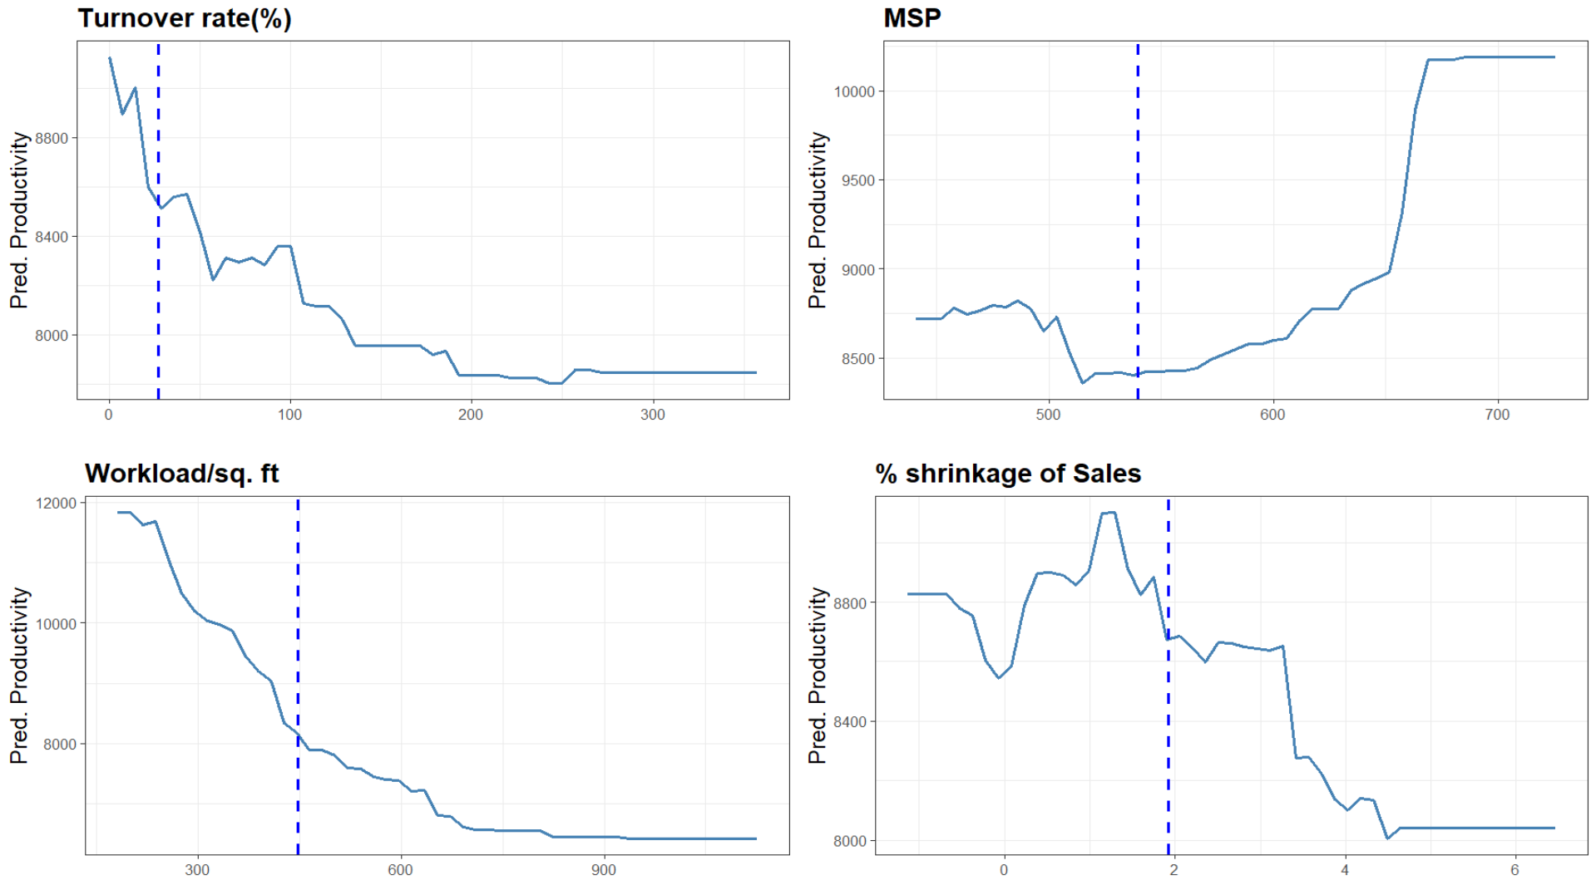
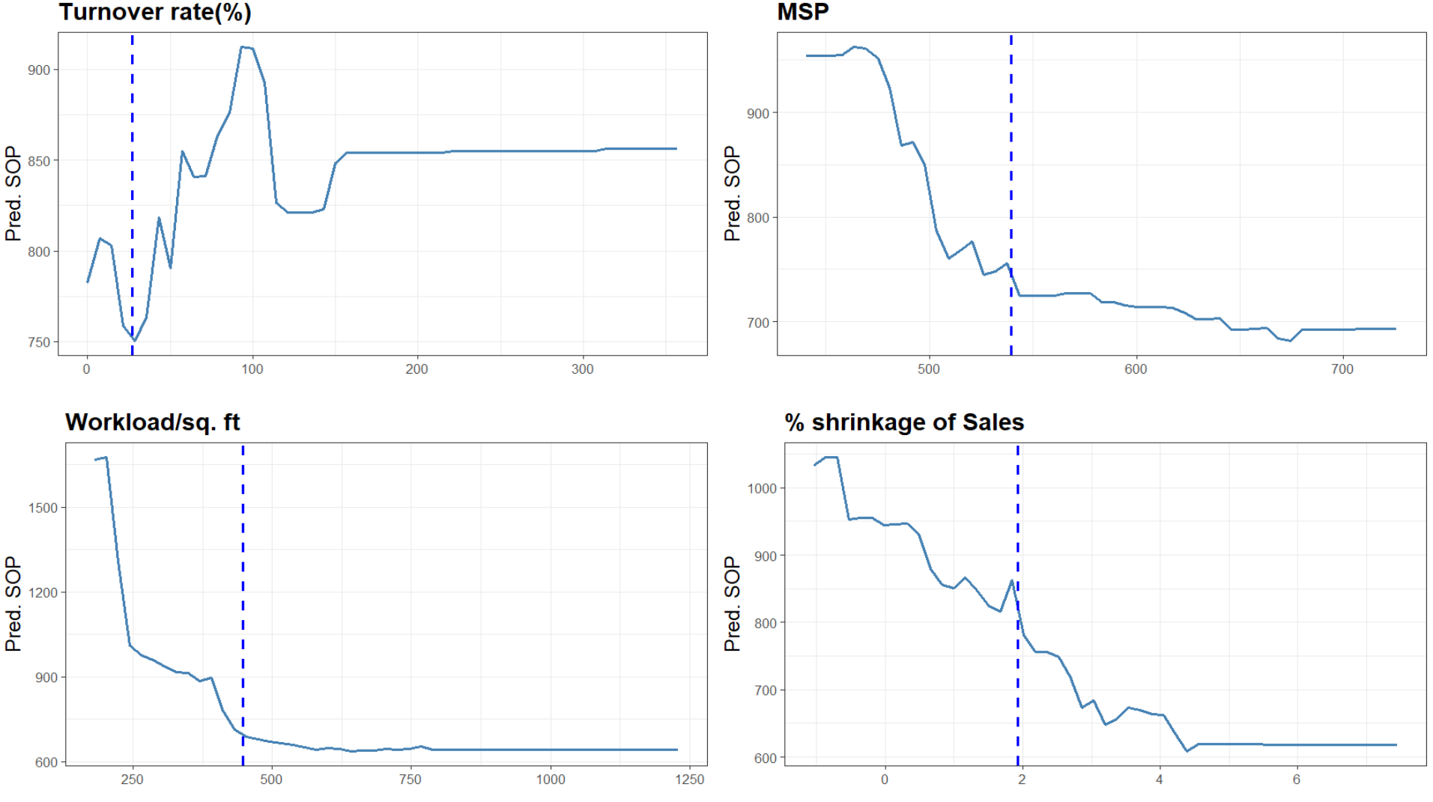
Appendix
Increment in Engagement
+ 1/2 scores in Wellcome
Need drivers: Q9 Asked Opinion ↑ 8 scores, Q16 Trust Leadership ↑ 9 scores , Q23 Meaningful Work ↑ 2-5 scores & Q30 Community support initiatives ↑ 14 scores
+ 3 scores in Wellcome
Need drivers: Q9 Asked Opinion ↑ 8 scores, Q16 Trust Leadership ↑ 9 scores, Q23 Meaningful Work ↑ 2-5 scores Q24 Given Enough Resources ↑ 6 scores, Q29 Technology resources ↑ 18 scores & Q30 Community support initiatives ↑ 16 scores
+ 1/2/3 scores in Overall stores
Need drivers: Q11 Career opportunities ↑ 4-7 scores & Q29 Technology resources ↑ 6-7 scores
+ 1/2 scores in SSC
Need drivers: Q23 Meaningful Work ↑ 9 scores, Q30 Community support initiatives ↑ 11 scores
+ 4 scores in SSC
Need drivers: Q20 Proud of Company ↑ 7 scores, Q23 Meaningful Work ↑ 9 scores, Q26 Being Cared ↑ 9 scores, Q29 Technology resources ↑ 12 scores & Q33 Leadership Team Demonstrates Commitment ↑ 8 scores
Productivity
Profitability

Slide 6
Appendix
Assumption
The headcount and head-exit in turnover rate is used the total sum of number of FT and PT, which assume that there are no differences between the FT turnover rate and PT turnover rate.
The independency of each variable has been assumed.
The average data could be represented each store and SSC.
Evidence Proof
Q29 Technology Resources is 1st driver in most of Glint metrics. In the score range from 55-70, every 5 points increase, 3% productivity gain. Thus, it has a simple explanation that better tools would faster tasks and fewer errors which cause higher sales per store.
Q9 Asked Opinion is 2nd importance driver in 3 Glint metrics and it would decrease 1% turnover rate in the Mass and Residential - Local (Wellcome) & decrease 9% turnover rate in Residential - Western & Top Income (Upscale). Also, 3% shrinkage would be decreased in Residential - Western & Top Income (Upscale) too.
Q23 Meaningful Work is 1st importance driver for Belonging Score and it would gain $4,086/store productivity in Upscales clusters when its score increase. Thus, it has a simple explanation that Employees who see their impact stay longer and more recommend stores.
Q30 Community Support is Top 3 importance driver in 3 Glint metrics. In the score range form 55-85, every 10 points increase, 5% customer trust(MSP) would also increase. Thus, it has a simple explanation that visible social responsibility builds employee pride and customer loyalty.
Q11 Career opportunities is 2nd driver for Work Satisfaction and the Top 10 importance driver in 4 Glint metrics. The stores with high Q11 scores could decrease 8-10% turnover rate.
Evidence: Engagement → Proﬁt Pathway
Engaged employees could provide better service which lead to higher customer satisfaction (MSP). High scores in Q21Consider Customer Needs could lower turnover rate and get high MSP. Also, it found that low turnover rate with higher customer satisfaction (MSP) could possibly increase 20% SOP. Thus, it has a simple business explanation that happy employees provide better service which increase the repeated customers and finaly increase sales of stores per year.
Limitation
Data Granularity
Store-level averages only (not individual)
Causality Gaps
Models show correlation, not proven causation
Model Accuracy
Predictive accuracy capped at 60%~80% in Engagement and Productivity analysis & ~20% in Profitability analysis
Exclude External Factors
Overfitting risk

